Slide 1
DEMO EXERCISE 1～3
Nhóm 1

Slide 2
Exercise 1
1. Create AWS account
2. Create 2 IAM groups: admin, dev
3. Find IAM Policies that:
- Has full access to all services, then assign this policy to group admin
- Full access to S3 and read only acess to other services, then assign this policy to group dev
4. Create 2 IAM users:
- Your name (template: dattt), add to group admin
- User dev, add to group dev
5. Login AWS Console with the 2 new users just created, try:
- Launching an EC2 instance
- Creating a new S3 bucket
Can you see the difference between these 2 users?
6. Use the root account, change the alias to your full name (e.g: tran-tuan-dat)
7. Delete user dev, create user teacher with read only access, send credential file to your teacher via ChatOps
8. Create a budget alarm to send notifications to your email when the cost reaches $5

Slide 3
Exercise 2
Create a new VPC with 4 subnets (2 public, 2 private) in which EC2 instances can connect to the internet
1. VPC CIDR: 10.0.0.0/16, recommended region: ap-southeast-1 (Singapore)
2. Subnets: 2 subnets in each AZ
- AZ a: 10.0.1.0/24 (public), 10.0.4.0/24 (private)
- AZ b: 10.0.2.0/24 (public), 10.0.5.0/24 (private)
3. Ensure all the subnets meet requirements
- Public subnets enable public IPs and can connect to the Internet
- Private subnets can connect to the Internet through NAT ($0.059/hour)
4. Create 1 Security Group aws-ccp-sg-ec2 with SSH All IPs, HTTP All IPs (Inbound)

Slide 4
Exercise 2: Create a new VPC
Chọn Region mong muốn
VPC dashboard
Click button [Create VPC]
Chọn VPC only (Chọn [VPC and more] sẽ tạo cả subnet nhưng không chỉ định được IP)
Ở IPv4 CIDR chỉ định 10.0.0.0/16
Click button [Create VPC]

Slide 5
Exercise 2: Create Subnets (2 in each AZ)
Ở menu bên trái click Subnet
Click button [Create Subnet]
Chọn VPC mong muốn
Nhập Subnet name
Chọn AZ mong muốn
- AZ a: 10.0.1.0/24 (public), 10.0.4.0/24 (private)
- AZ b: 10.0.2.0/24 (public), 10.0.5.0/24 (private)
6. Click Add new subnet, thực hiện lại step 1-5
7. Click button [Create Subnet]

Slide 6
Exercise 2: Setting Subnets
Setup Internet Gateway:
Ở menu bên trái click Internet gateways
Click button [Create Internet gateways]
Nhập Internet gateways name
Click button [Create Internet gateways]
Setting in Route table – Public subnet:
Ở menu bên trái click Route table
Click button [Create Route table]
Nhập Route table name
Click button [Create Route table]
Chọn tab Route, click button Edit routes
Set rule
Click tab subnet association, chỉ định Public Subnet bằng cách liên kết với IGW
Setup NAT gateways – Private subnet:
Ở menu bên trái click NAT gateways
Click button [Create NAT gateways]
Nhập NAT gateways name
Chọn Public Subnet
Click button [Create NAT gateways]
Tab Route: Chỉ định subnet với target đến NAT

Slide 7
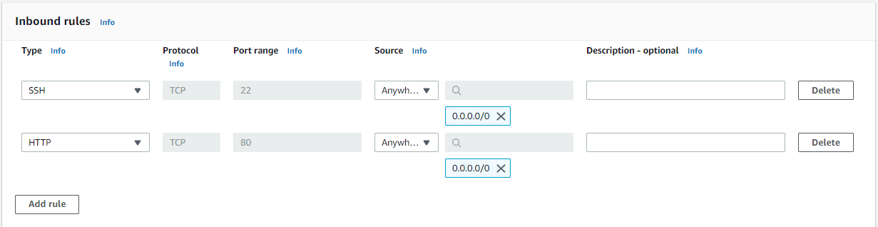
Exercise 2: Create Security Group
Ở menu bên trái click Security groups
Click button [Create Security groups]
Nhập Security groups name (aws-ccp-sg-ec2)
Chọn VPC
Set inbound rule (như hình)
Click button [Create Internet gateways]

Slide 8
Exercise 3
1. Create an EC2 instance and install Apache web server using User Data, located in a public subnet
User Data:
#!/bin/bash
# Use this for your user data (script from top to bottom)
# install httpd (Linux 2 version)
yum update -y
yum install -y httpd
systemctl start httpd
systemctl enable httpd
echo "<h1>Hello World from $(hostname -f)</h1>" > /var/www/html/index.html
2. Setting a Security group for an EC2 instance which allows HTTP and SSH for all sources
3. SSH to instance and change the content of the file index.html as the following: “Hello Teacher from <your hostname>”
4. Prevents an instance from accidental termination

Slide 9
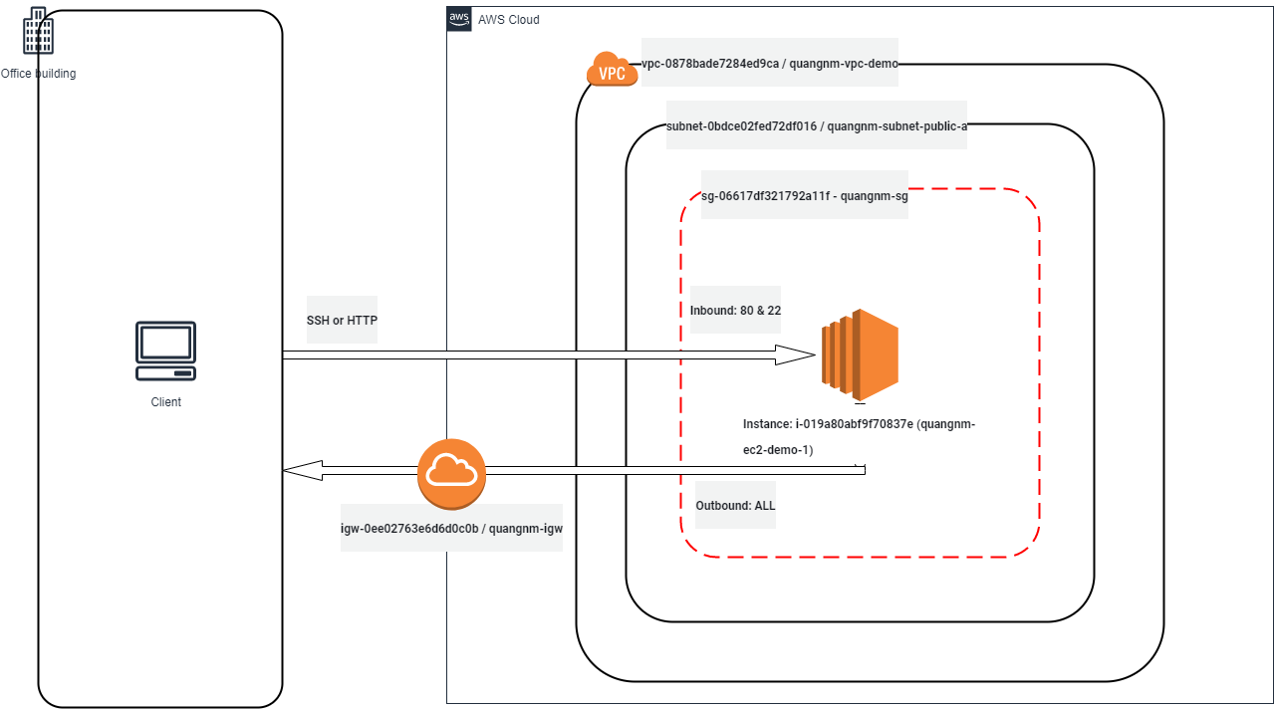

Slide 10
Exercise 3: Create EC2 & setting Security group
EC2 dashboard
Click button [Launch instance]
Nhập instace name, type, key pair, VPC, v.v…
Enable Auto-assign public IP
Chỉ định security group (Dùng SG ở exercise 2)
Ở Advanced details nhập User data
Click button [Launch instance]

Slide 11
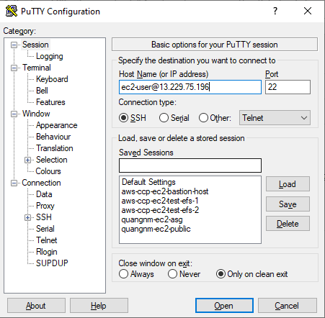
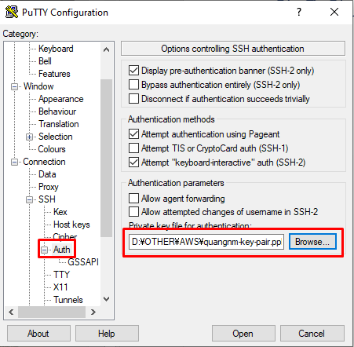
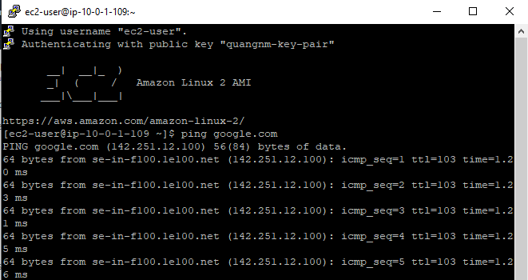
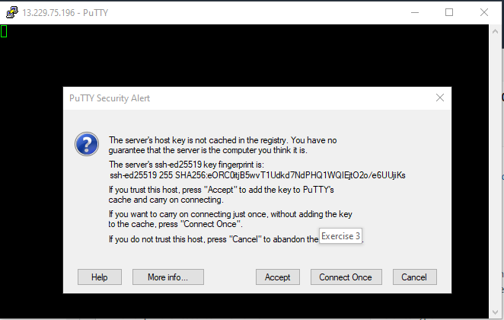
Exercise 3: SSH to instance & change content (Cách dùng Putty)
Nhập IP address( Thông thường sẽ có format như: ec2-user@<public IP>
Thêm key pair của EC2 vào Putty
Click Open để ssh, click accept để access vào ec2
Để kiểm tra xem ec2 đã được đi ra internet hay chưa, ta dung lệnh ping <trang web>

Slide 12
Exercise 3: Protect termination
EC2 dashboard
Chọn EC2 cần setting
Chọn [Action] → Chọn [Change termination protection ]
Click chọn Enable
Click button Save

